Slide 1
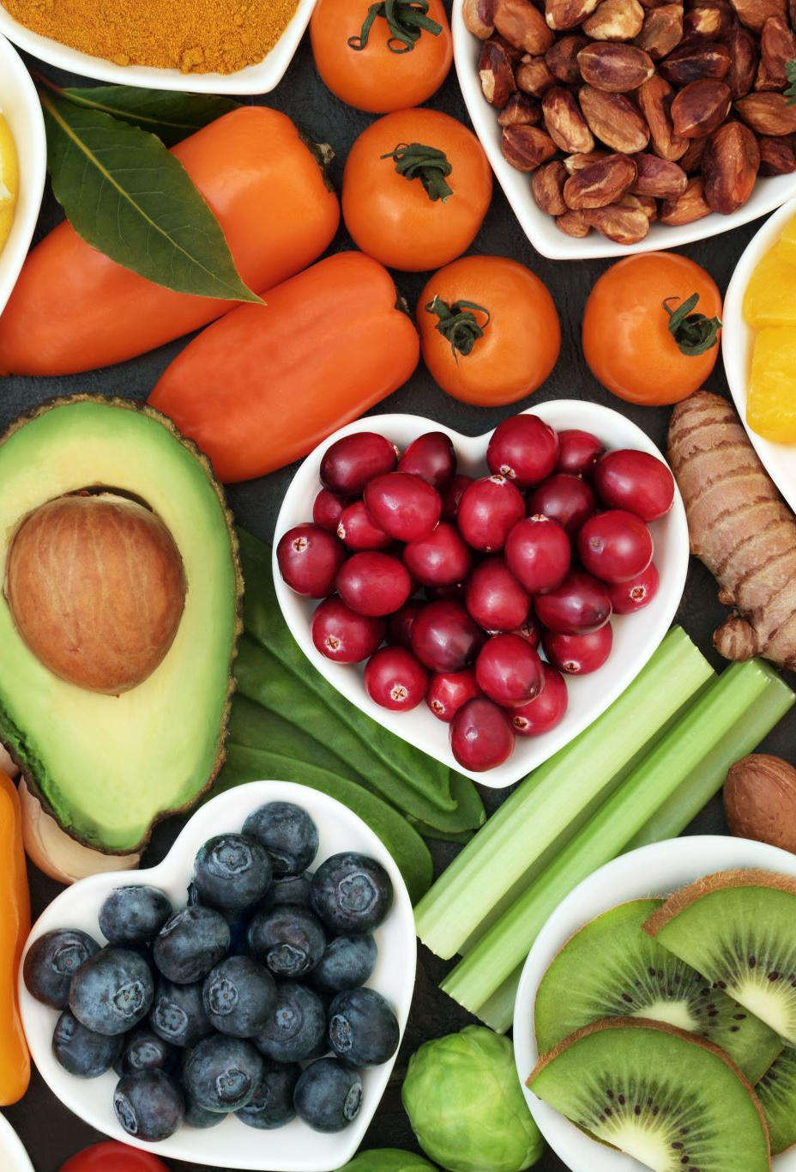
AI-Driven Food Nutrition Predictor (Predicting Macro Nutritional Content of Food via Deep Learning)

Slide 2
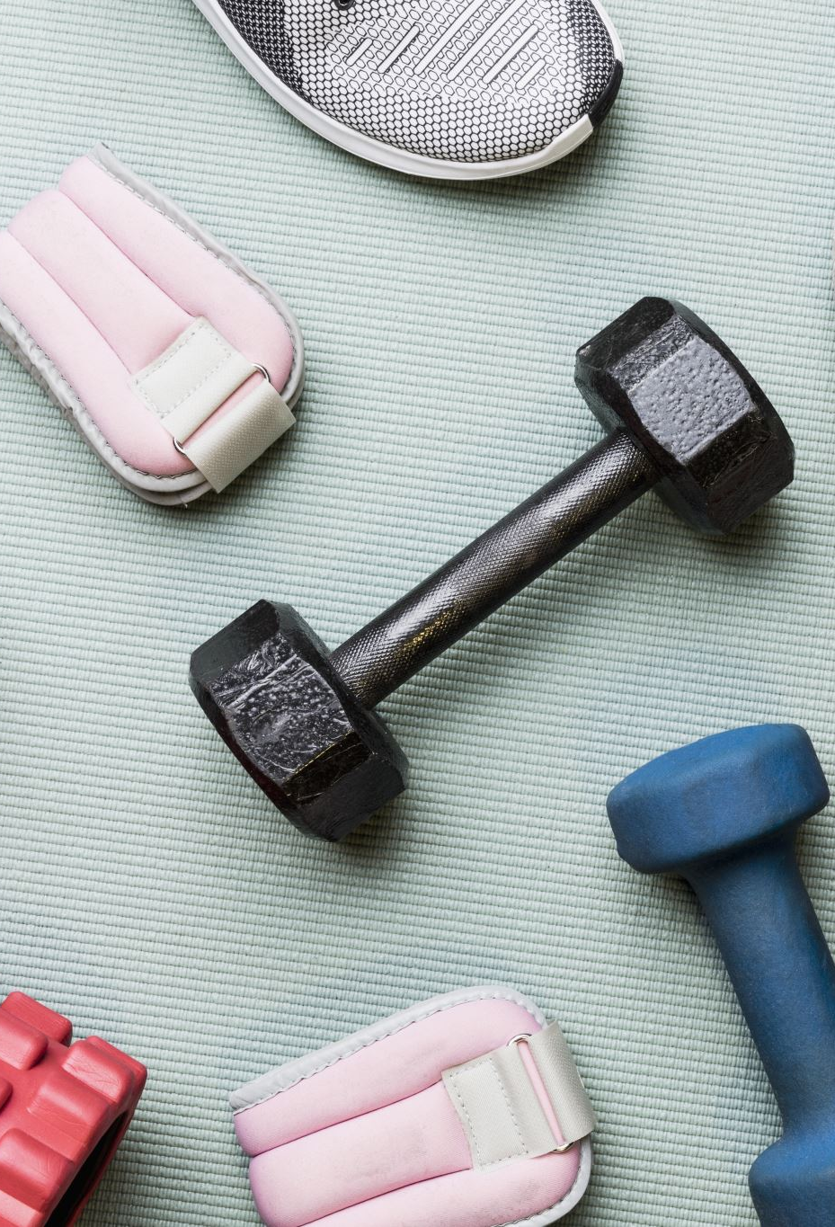
The Opportunity
Lack of accessible tools to accurately measure nutritional content.
Growing interest in health and fitness tracking.
Target Audience: Fitness enthusiasts, health-conscious individuals, dieticians.

Slide 3
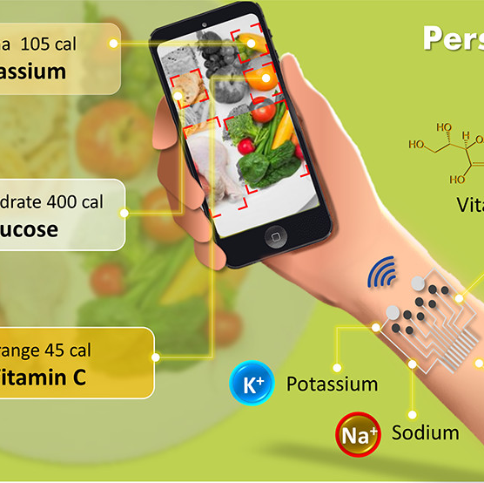
Our Solution: NutriTrack
Core Features: Estimates food grade in real time.
Integration: Syncs with wearables like Fitbit for holistic health tracking.
Impact: Simplifies nutrition management for health-conscious individuals.

Slide 4
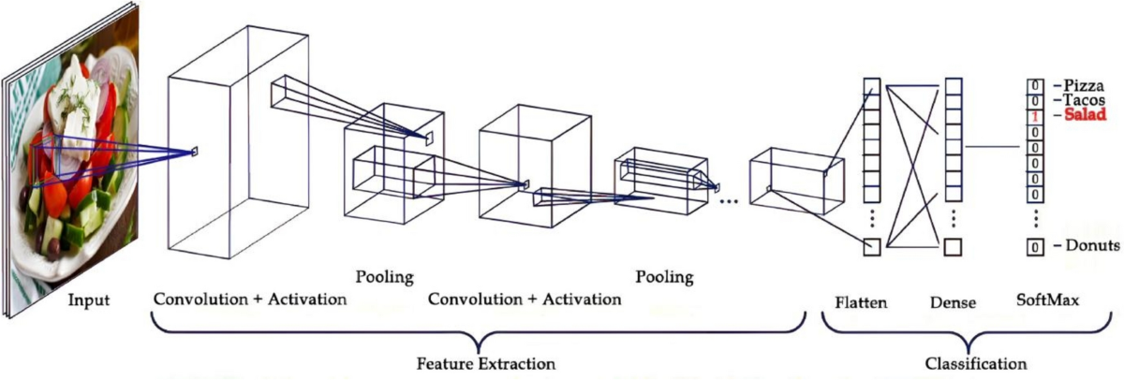
Technical Framework
Model:
1st CNN Layer
8 Filters, 4*4 Kernel, Activation: ReLU
Max Pool (2*2)
2nd CNN Layer
8 Filters, 3*3 Kernel, Activation: ReLU
Max Pool (2*2)
Flattening Layer
1st Dense Layer
16 Units, Activation: ReLU
Dropout Layer
30%
Output Layer
7 Units
Input:
IMG Height
IMG Width
3 RGB colors
Output:
7 Food Grades.

Slide 5

The Process

Slide 6
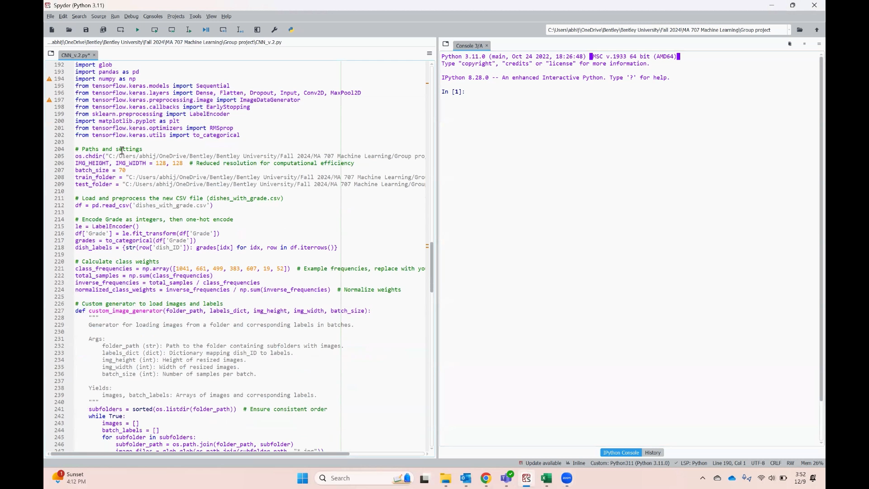
CNN Model

Slide 7
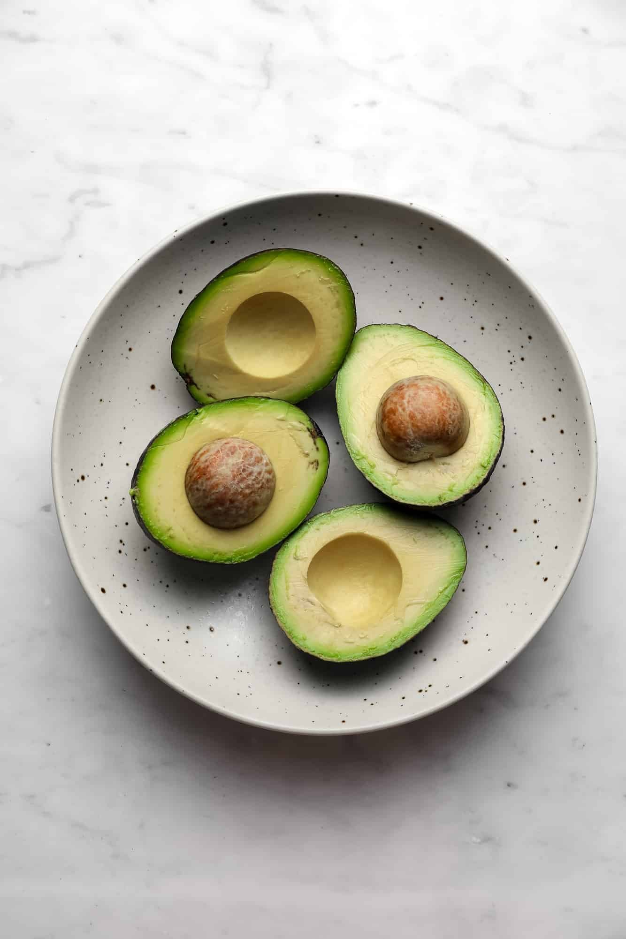
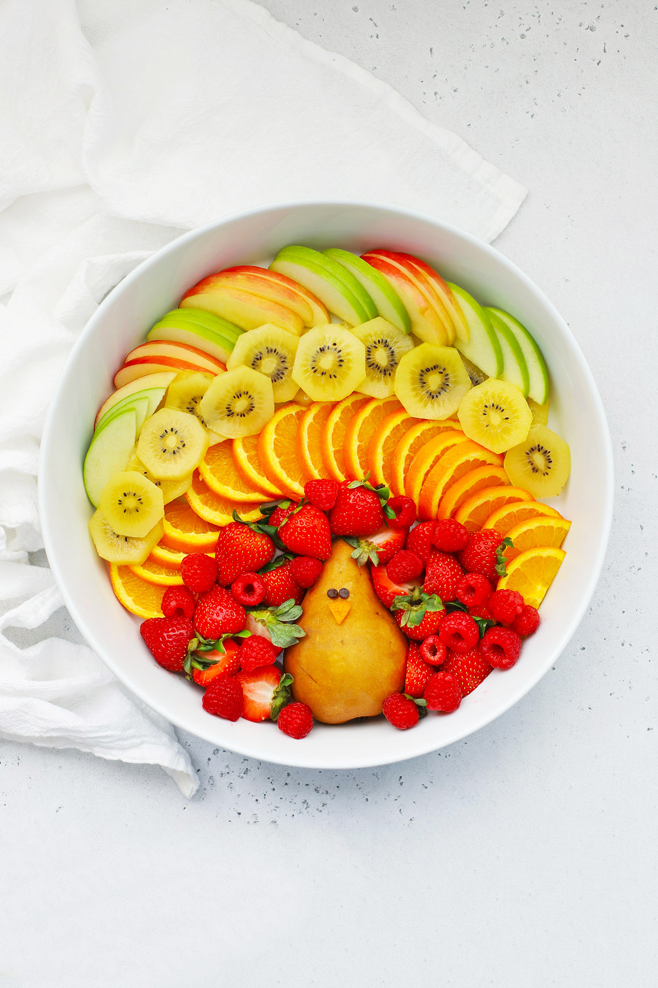
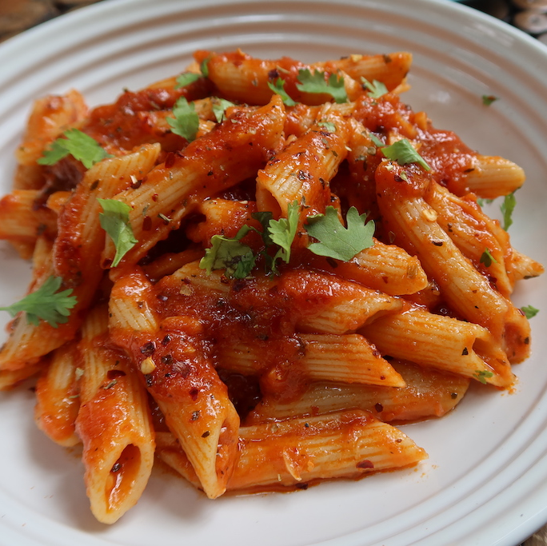
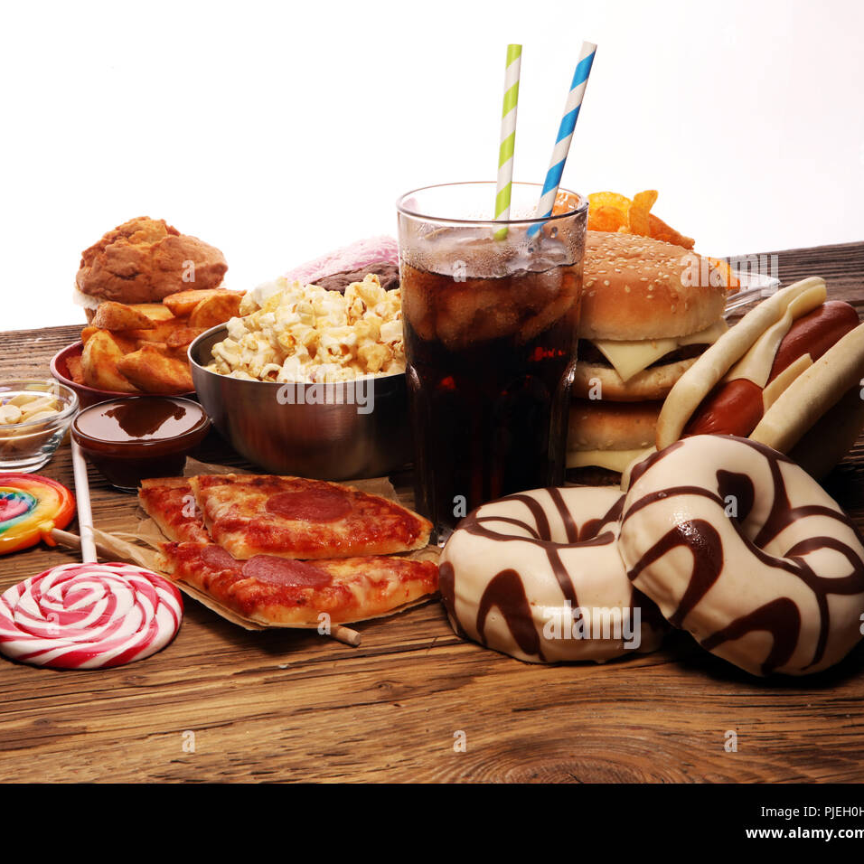
Proof of Concept
Food Image Analysis: Predicts Food Grades using photos.
Real-Time Predictions: Instant feedback to aid dietary choices.
Wearable Integration: Syncs with Fitbit and similar devices for a complete health tracking experience.
Customizable Logging: Allows users to save and track their meals over time.
Truly Customizable: Unlike following a generic diet plan on the web, users would be empowered with information that is generated on wearables in conjecture with NutriTrack.

Slide 8
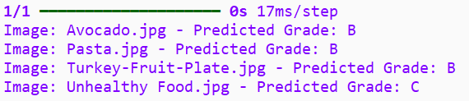
Model Dictionary & Results
Ideal Macro Ratios
Fat to Protein | 0.5 to 2
Carb to Protein | 0.5 to 2
Grade Mapping
Food Grades | Score
A+ | 20
A | 10
B | 5
B+ | 0
C | -5
D | -1
F | -15
Points Based on Deviation
Ideal | +10
Very High C/P Ratio | -5
Very High F/P Ratio | -10
Results
Unseen Picture | Predicted Grade
Avocado | B
Pasta | B
Fruit Bowl | B
Unhealthy Food | C

Slide 9
Why Us?
Competitors: Calorie Mama, Bite AI, Foodvisor, and Diet Camera AI
Differentiators: Unlike most competitors, our focus is on integrating with wearables like Fitbit and offering a unique selling point for seamless activity and dietary monitoring.

Slide 10

Business Potential
Partnership with Wearable Brands.
Fitness apps market:
Expected to grow at CAGR of 21.6% from 2021 to 2028.
Expected to continue growing at a CAGR of 29.95%, reaching USD 56.29 billion by 2030.
Global wellness apps market:
Size was estimated at USD 9.67 billion in 2023
Projected to grow at a CAGR of 15.1% from 2024 to 2030

Slide 11
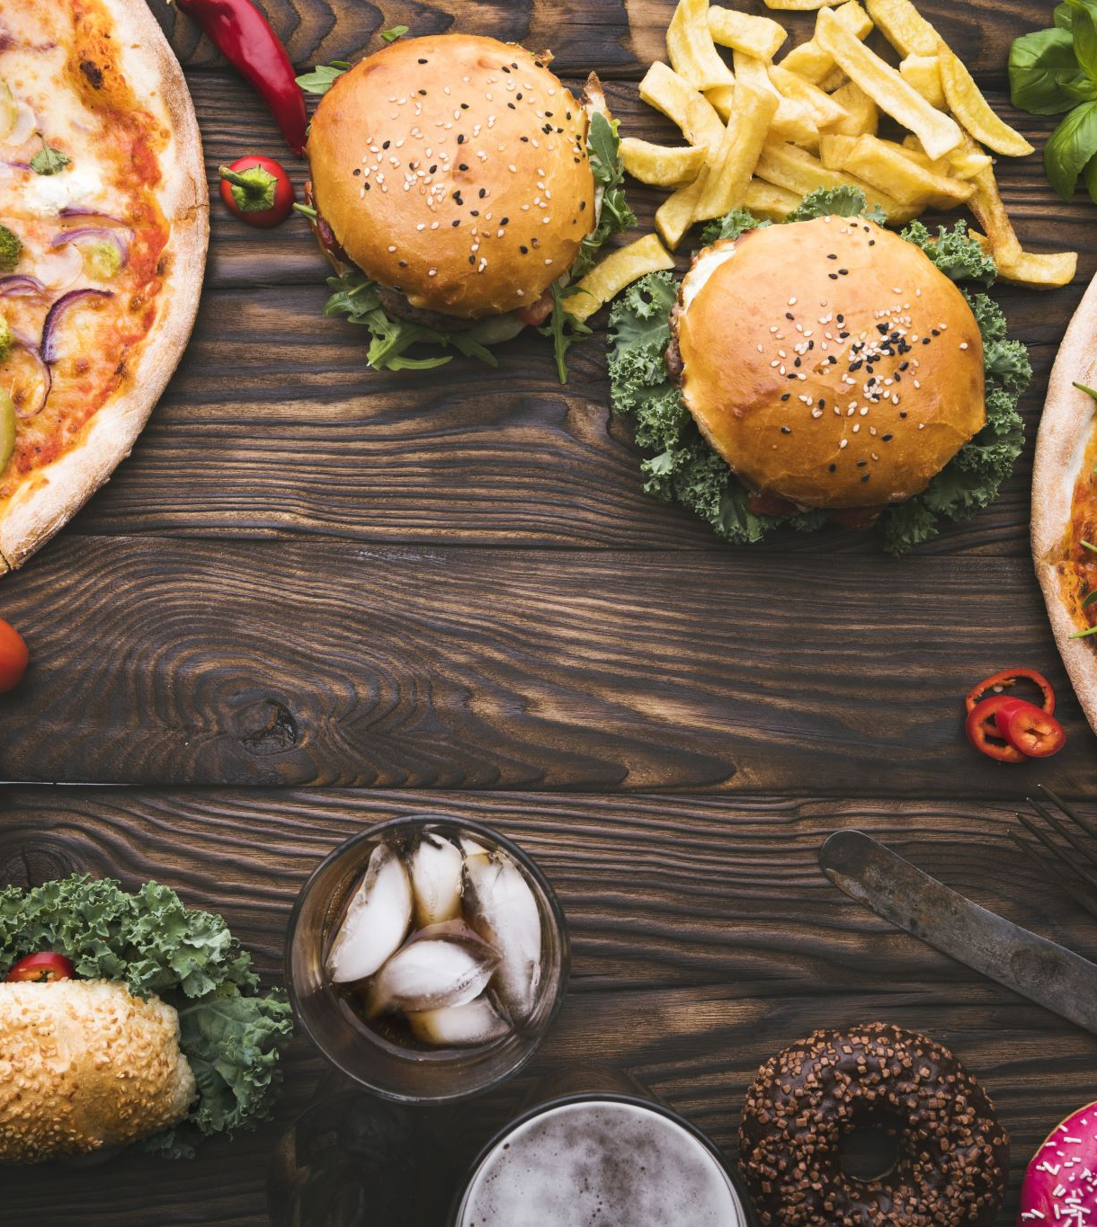
Responsible AI
User Data Privacy:
User Data Encryption
Possibility to go Incognito
Opt-in to Share Data
Proactive Ethics:
Transparency about rating scales
Encourage consults with physicians
Caution:
No dieting behavior nudging
No claims of authority or expertise

Slide 12

Impact
Individual: Healthier Lifestyle
Accountability for personal goals
Follow-through on provider advice
Society: Fitness & Wellness trends
Community-building & dish-sharing
Intercultural, global connections

Slide 13
Legal
Compliance:
Entertainment purposes
No need for FDA approval
Safety:
User discretion
Ingestion risks
Intellectual Property:
Trademarks
Copyrights

Slide 14

Next Steps
Improving Accuracy of food grade and predict macro nutrients.
Building a User-Friendly App Interface.
Partnership Outreach with Fitbit, etc.

Slide 15
What are we eating tonight?

Slide 16
References
Das, S. K., Miki, A. J., Blanchard, C. M., Sazonov, E., Gilhooly, C. H., Dey, S., Wolk, C. B., Khoo, C. S. H., Hill, J. O., & Shook, R. P. (2022, February 1). Perspective: Opportunities and challenges of technology tools in dietary and activity assessment: Bridging Stakeholder viewpoints. NIH National Library of Medicine: National Center for Biotechnology Information. https://pmc.ncbi.nlm.nih.gov/articles/PMC8803491/
Grand View Research. (2024). Wellness Apps Market Size, Share And Growth Report, 2030. https://www.grandviewresearch.com/industry-analysis/wellness-apps-market-report
Open Food Facts. (n.d.). Open Food Facts: The free food products database. Discover. https://world.openfoodfacts.org/discover

Slide 17
References
Research and Markets. (2024, October). Fitness app market size, competitors & forecast to 2030. Fitness App Market Size, Competitors & Forecast to 2030. https://www.researchandmarkets.com/report/fitness-app
Ryan, M. (2022). The ethics of dietary apps: Technology, health, and the capability approach. Technology in Society, 68, 101873. https://doi.org/10.1016/j.techsoc.2022.101873
Spraul, T. (2024, October 7). 50+ fitness app statistics (revenue, market size, usage, + more) in 2024. How to Make a Fitness App. https://www.exercise.com/grow/fitness-app-statistics/
World Intellectual Property Organization (WIPO). (n.d.). Intellectual Property Rights for Mobile Applications. https://www.wipo.int/en/web/mobile-apps

